Slide 1
Atomic Bomb
Documents

Slide 5
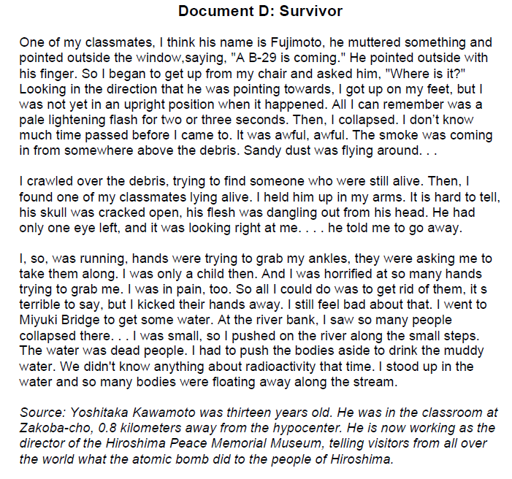

Slide 6
